Slide 1
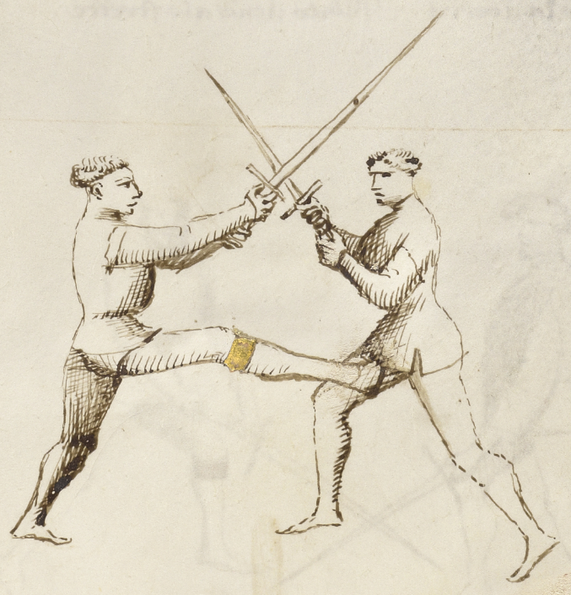
Plate 10: (26r-d) 7th Student and counter
This play, where I strike you with a kick to the groin, is made to hurt you so much that your cover will falter. When you make this play you should do it quickly, to prevent your opponent from being able to counter it.
The counter to this play must be done quickly, and is made by the player grabbing the student’s right leg with his left hand, and then throwing him to the ground.

Slide 2
Plate 10: (26r-d) 7th Student and counter

Slide 3
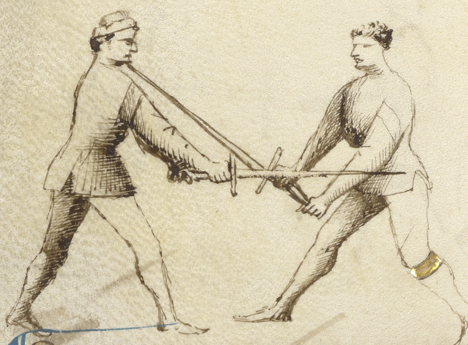
Plate 11: (26v-a) 8th Student “Exchange of Points/Thrusts”
This play is named “The Exchange of Points”, and it is done like this: when your opponent thrusts at you, quickly advance your front foot off the line, and with the other foot step to the side, also moving off the line, crossing his sword with your hands low and with your point high into his face, or chest, as you see drawn here.

Slide 4
Plate 11: (26v-a) 8th Student “Exchange of Points/Thrusts”

Slide 5
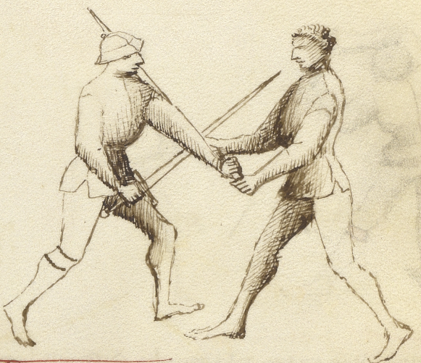
Plate 12: (26v-b) 9th Student
This play comes from the exchange of points that came before me. If you make the thrust, and your opponent fails to immediately position his point either into your face or into your chest, perhaps because you are in armor, then you should quickly pass forward with your left foot, and seize his sword as shown here. Then strike him hard with your sword, since you have his sword gripped and he cannot escape.

Slide 6
Plate 12: (26v-b) 9th Student

Slide 7
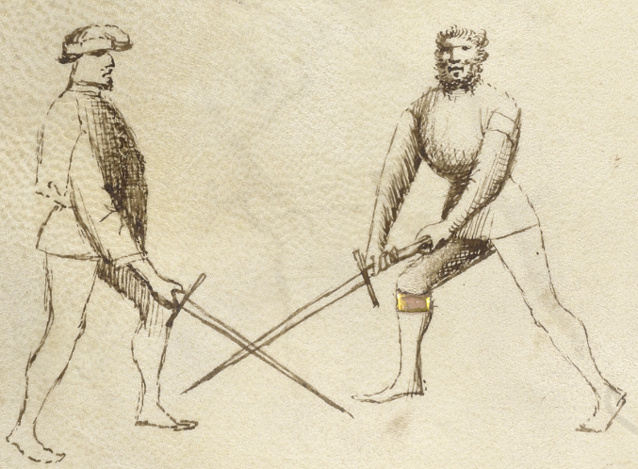
Plate 13: (26v-c) 10th Student “Breaking the Thrust”
This is another defense you can make against the thrust. When someone thrusts at you as described in the “Exchange of Thrusts”, two plays before me, then you must advance and step off the line. You should do the same thing in this play, except that in the “Exchange of Points” you thrust back with your hands low and your point high, as I explained earlier. But in this play, which is named “Breaking the Thrust”, you proceed with your hands high and as you advances and step off the line you strike downwards, crossing the opponent’s thrust at mid-sword, and driving it to the ground. Then you quickly close to grapple

Slide 8
Plate 13: (26v-c) 10th Student “Breaking the Thrust”

Slide 9
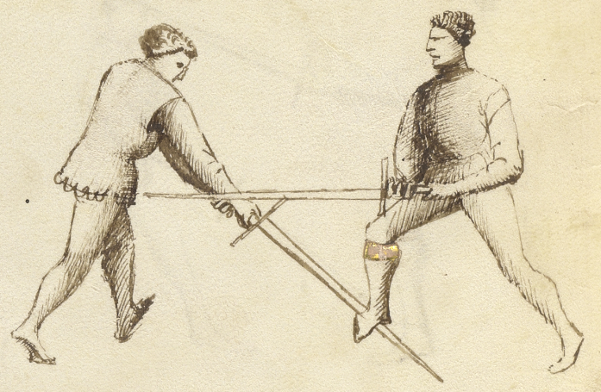
Plate 14: (26v-d) 11th Student
The student who preceded me beat his opponent’s sword to the ground. Now I am going to complete his play, as follows: after I beat my opponent’s sword to the ground I stomp on it with my right foot. This will either break it or prevent him from being able to lift it. But wait—there’s more. As soon as I have pinned his sword to the ground with my foot, I strike him with the false edge of my sword under his beard or into his neck. And then immediately I will return with a downward strike of my sword to his arms or his hands, as you see drawn here.

Slide 10
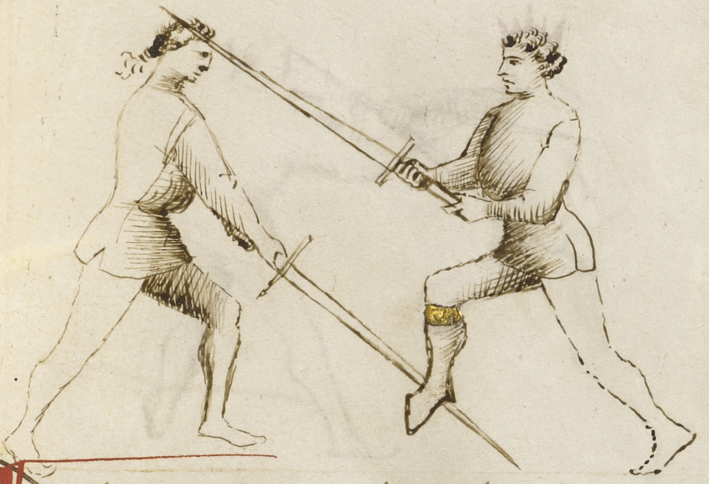
Plate 15: (27r-a) 12th Student
Here is another drawing of the “Breaking the Thrust” play, that you saw first two drawings previously. After I have beaten his sword to the ground I quickly pin it to the ground with my right foot, and then strike him in the head, as you see shown here.

Slide 11
Plate 14 & 15

Slide 12
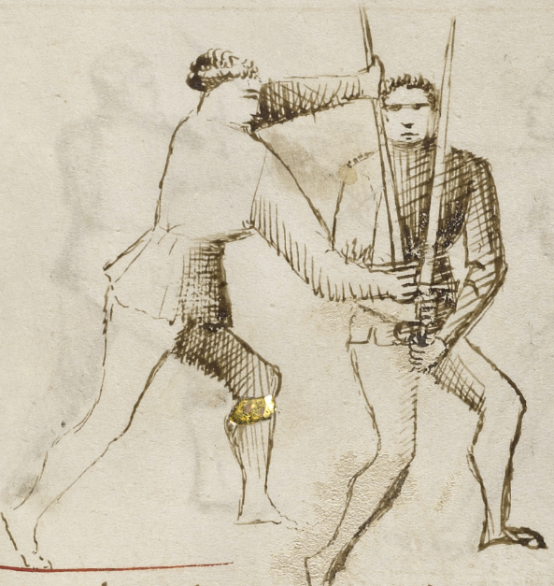
Plate 16: (27r-b) 13th Student
This is another play that flows from the “Breaking of the Thrust” play. After I break his thrust, if he raises his sword to cover as I strike upwards, I quickly drop the hilt of my sword inside his right arm, near his right hand, then I grab my blade near the point with my left hand, and then strike him in his face. Or alternatively, if I chose, I could drive my sword edge into his neck, slicing him across his throat.

Slide 13
Plate 16: (27r-b) 13th Student

Slide 14
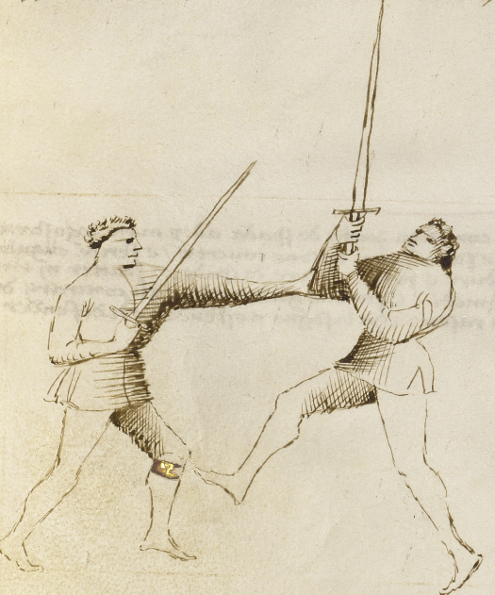
Plate 17: (27r-c) 14th Student
Also, after I have beaten aside or crossed my opponent’s sword, I can press my left hand to his right elbow and push strongly. This will turn him and leave him unprotected, after which I can strike him.

Slide 15
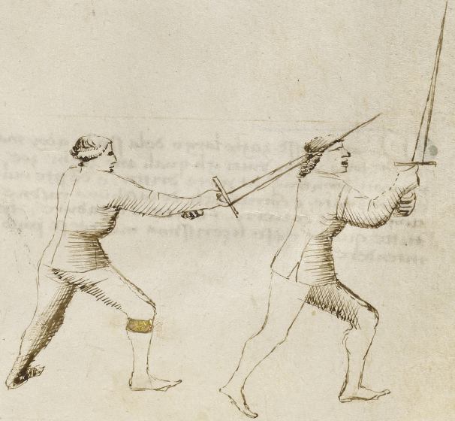
Plate 18: (27r-d) 15th Student
The student who preceded me spoke truly when he told you that he could turn the opponent and cut to his head. In addition, before you could turn back to make cover I would give you a major wound in your back with the point of my sword.

Slide 16
Plate 17 & 18

Slide 17
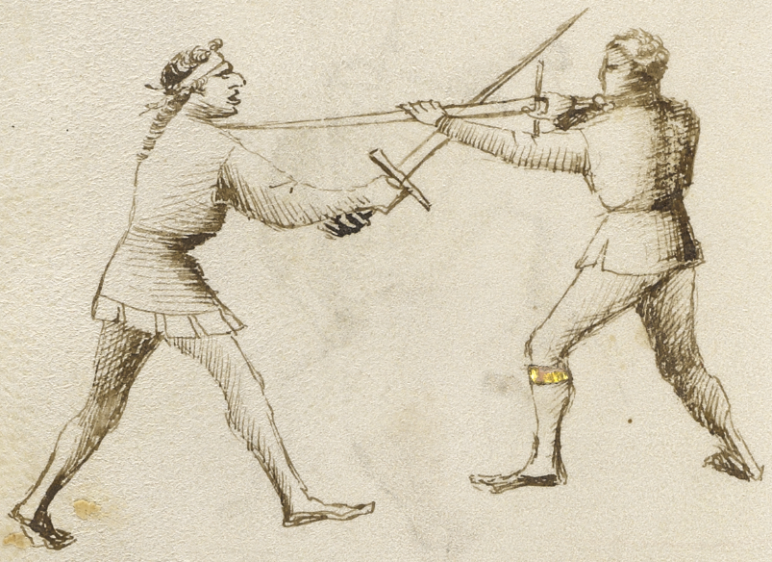
Plate 19: (27v-a) 18th Student “False Thrust”
This play is named “The False Point” or “The Short Point”, and I will explain how to do it. I make it look like I am making a powerful attack against my opponent with a crosswise strike to his head. As he makes cover I strike his sword but only lightly. Then I quickly turn my sword to the other side of his blade, gripping my sword with my left hand at about mid-sword. From there I can quickly make a thrust into his throat or chest. This play is however better in armor than without armor.

Slide 18
Plate 19: (27v-a) 18th Student “False Thrust”

Slide 19
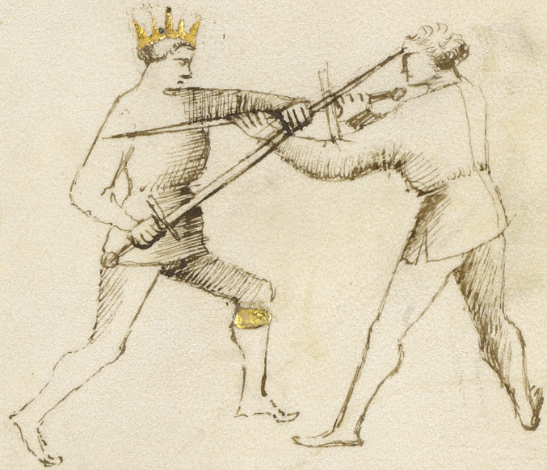
Plate 20: (27v-b) Counter to 16th Student
This play is the counter to the previous play, the False Point or the Short Point. And this counter is made like as follows: when the student strikes my sword lightly and then turns his sword around to the other side, I turn my sword around his in exactly the same way, stepping sideways to the left as I do so to gain his unprotected side. From here I can make a thrust into his face. And this counter is good both with or without armor

Slide 20
Plate 20: (27v-b) Counter to 16th Student

Slide 21
(27v-c) Largo Conclusion
Here ends the Wide Play of the sword in two hands, made up of plays that are all connected to each other, including remedies and counters from both the right and left sides, and counter-thrusts and counter-cuts to each situation, with breaks, covers, strikes and locks, all things that can be easily understood.

Slide 22
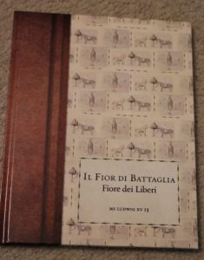
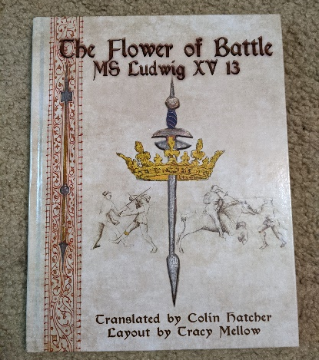
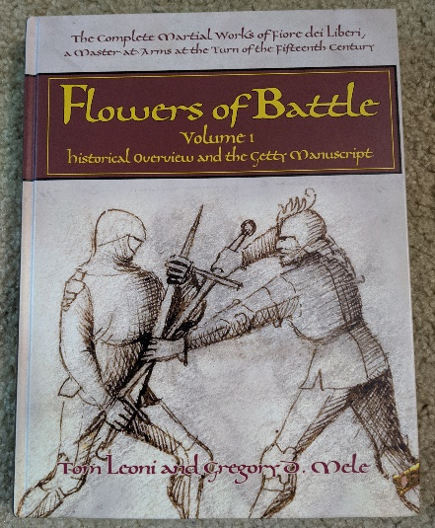
Bibliography - The Manual Itself
Il Fior Di Battaglia: MS Ludwig XV 13, Fiore Dei Liberi , ISBN 978-9527157114, $30. Buy it on Amazon Facsimile of book with Original Italian
The Flower of Battle: MS Ludwig XV13, Hatcher, Colin and Mellow, Tracy, ISBN 978-0984771684, $40. Buy it on Amazon Fiore’s manual with text replaced by typed English in similar font.
Flowers of Battle: The Complete Martial Works of Fiore dei Liberi Volume One: The Getty Manuscript and Historical Contex, ISBN: 978-1-937439-18-7, $125. freelanceacademypress.com Each page presented as a facsimile with translation on opposite page, plus lots of background information
Amazon links are affiliate links

Slide 23
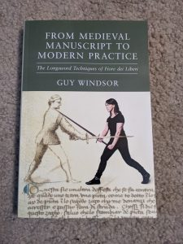
Bibliography - Interpretations
Fiore dei Liberi’s Armizare: The Chivalric Martial Arts System of Il Fior Di Battaglia, Charrette, Robert N., ISBN: 978-0-9825911-7-8, $40. Buy it on Amazon
Mastering the Art of Arms Series by Guy Windsor
Vol. 1: The Medieval Dagger, ISBN: 978-1937439033, $24. Buy it on Amazon Vol. 2: The Medieval Longsword, ISBN: 978-9526819327, $30. Buy it on Amazon Vol. 3: Advanced Longsword: Form and Function, ISBN: 978-9527157060, $30. Buy it on Amazon
From Medieval Manuscript to Modern Practice: The Longsword Techniques of Fiore dei Liberi, Windsor, Guy, ISBN-13 : 978-9527157558, $25. Buy it on Amazon
Amazon links are affiliate links

Slide 24
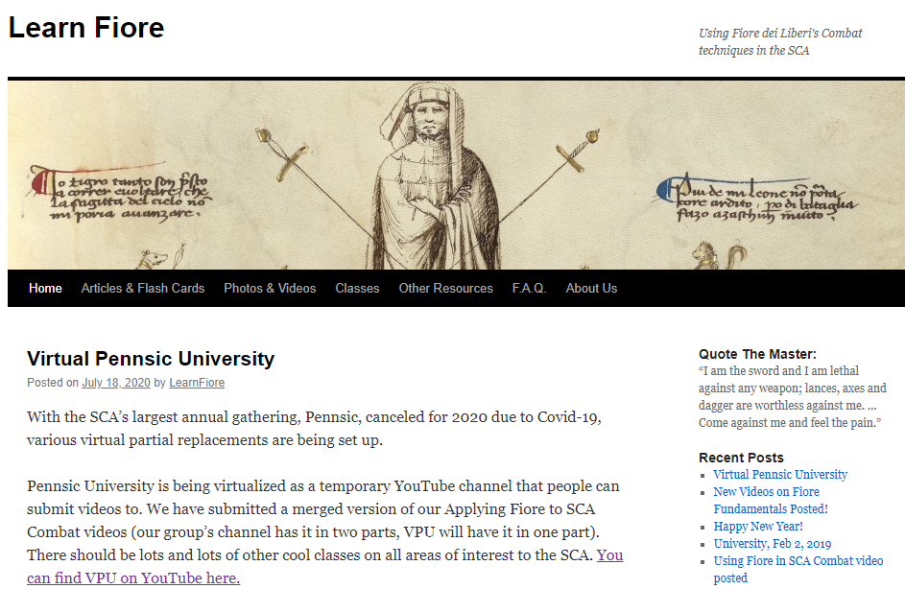
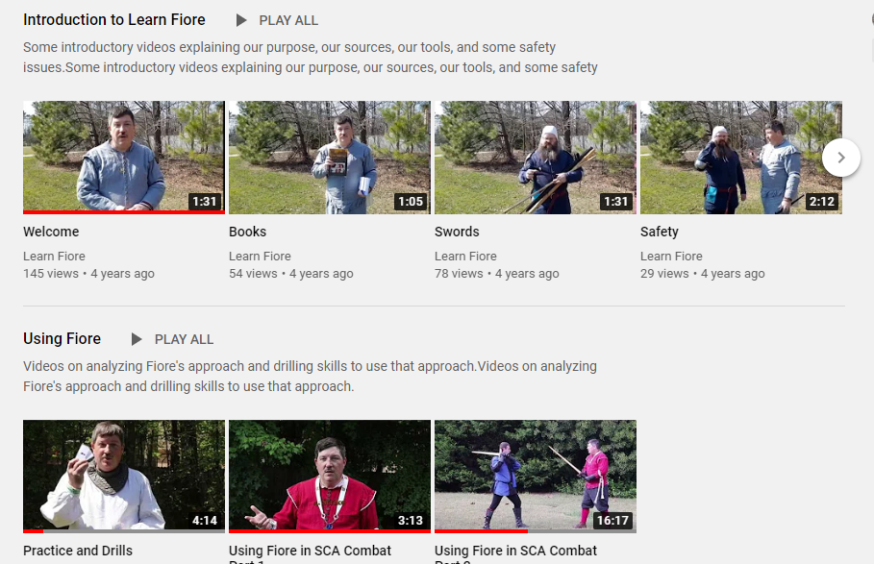
Tir-y-Don Fiore Study Group
Website: LearnFiore.org
YouTube channel: https://www.youtube.com/channel/UCm_ZYLv4GLH4deU5NXXhUWQ

