Slide 1
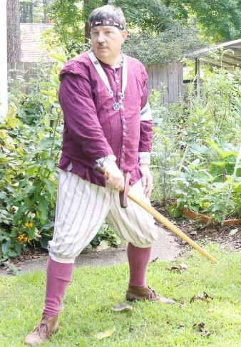
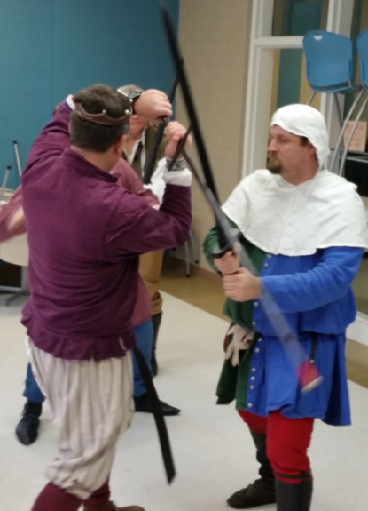
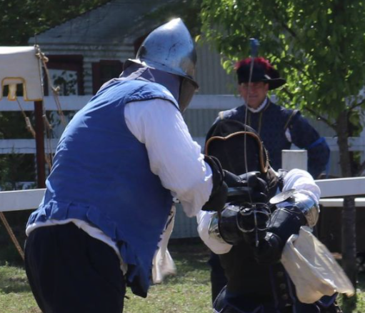
Using Fiore Longsword in SCA Combat
Documentation for
Master Llwyd Aldrydd, OP, OD
BaronLlwyd.org
LearnFiore.org
BaronLlwyd@gmail.com

Slide 2
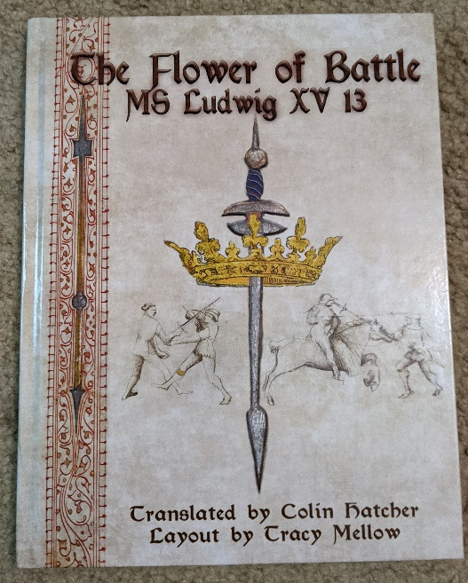
Sources
Images from Getty Museum
http://www.getty.edu/art/collection/objects/1443/unknown-fiore-furlan-dei-liberi-da-premariacco-il-fior-di-battaglia-italian-about-1410/
Translations by Colin Hatcher
The Flower of Battle: MS Ludwig XV13 by Colin Hatcher (Translator), Tracy Mellow (Designer), ISBN-13: 978-0984771684
or: https://wiktenauer.com/wiki/Fiore_de%27i_Liberi

Slide 3
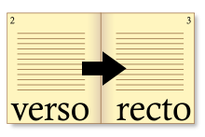
Quick Background
1409 publication
Earliest known complete European combat system
Sections include wrestling, dagger, swords, armored combat, pikes, spears, and mounted combat
4 copies known to survive, the Getty copy is the most complete, each is different
Page numbering
Each sheet of paper/vellum is numbered
Front of each sheet is called “recto” or abbreviated “r”
Back of each sheet is called “verso” or “v”
Master is indicated with a gold coronet/crown
Scholar is indicated by a gold garter
Image source: wikipedia

Slide 4
Related Fiore Videos
I have several short YouTube videos on basics like holding the sword, stance, cuts, and footwork available at:
https://www.youtube.com/playlist?list=PLqW3haG97oKuI3IzIBzlKg9vzIIk-sX-1
Some related videos on using Fiore in the SCA are available at
https://www.youtube.com/playlist?list=PLqW3haG97oKtUrvYHtAHlqSZSHSZOWdHo

Slide 5
Fiore’s Plays for SCA Combat
This class covers a sample of plays from across Fiore’s manual including plays from
Sword in Two Hands – Long Range
Sword in Two Hands – Short Range
Sword in One Hand
Armored Sword
Plays are chosen to be usable in many SCA combat forms with limited modifications

Slide 6
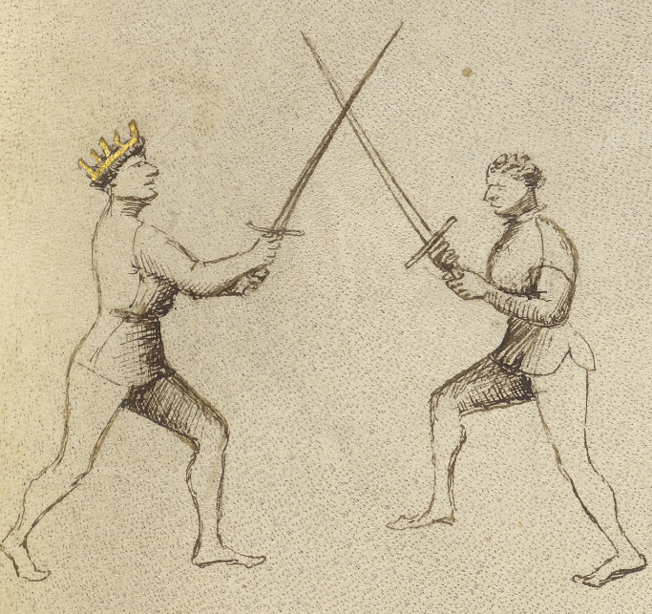
Plate 1: (page 25r-c) 1st Remedy Master
Sword in
Two Hands
Long Range
Here begins the Wide Play of the sword in two hands.
This Master who is crossed at the point of his sword with this player says: “When I am crossed at the points, I quickly switch my sword to the other side, and strike him from that side with a downward blow to his head or his arms. Alternately, I can place a thrust into his face, as the next picture will show.”

Slide 7
Plate 1: (25r-c) 1st Remedy Master
Sword in
Two Hands
Long Range

Slide 8
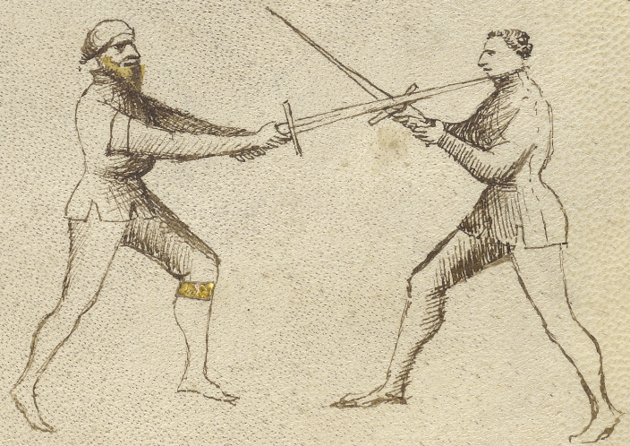
Plate 2: (25r-d) Student
Sword in
Two Hands
Long Range
I have placed a thrust into his face, as the previous Master said. Also, I could have done what he told you, that is, when my sword was crossed on the right I could have quickly switched sides to the left, striking his head or arms with a downward blow.

Slide 9
Plate 2: (25r-d) Student
Sword in
Two Hands
Long Range

Slide 10
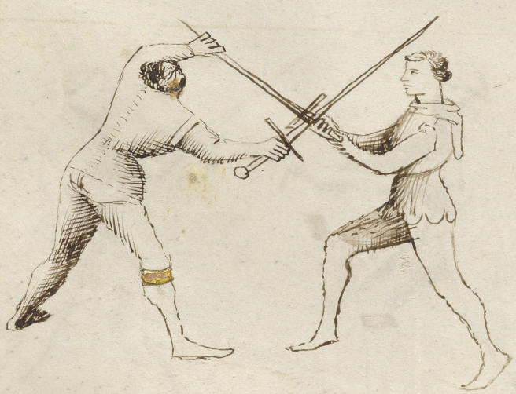
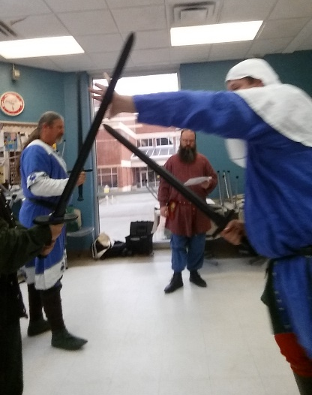
Plate 3: (25v-c) 2nd Student
Sword in
Two Hands
Long Range
My master previously instructed me that when I am crossed at mid-swords with my opponent, I should immediately advance forward and seize his sword as shown, and then strike him with a cut or a thrust. Also I could destroy his leg as you see drawn next, by stomping with my foot against the side of his knee or under the kneecap.

Slide 11
Plate 3: (25v-c) 2nd Student
Sword in
Two Hands
Long Range

Slide 12
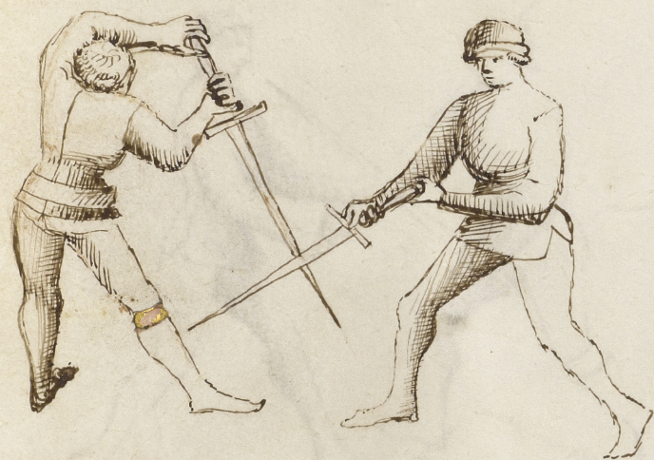
Plate 4: (26r-a) 4th Student (Peasant’s Blow/Strike)
Sword in
Two Hands
Long Range
This play is named “The Peasant’s Strike” and you do it like this: take a narrow stance with your left foot forward, and wait for the Peasant to attack first with his sword. When he launches his attack, immediately advance your left foot to the left off the line, and step diagonally off line to the left with your right foot, receiving his strike in the middle of your sword. Now let his sword slide off yours to the ground, and then quickly counter-attack with a downward strike to his head or arms, or a thrust into his chest as you see drawn in the next picture. This is also a good play if you are fighting sword versus poleaxe, or against a heavy or light staff.
Video: https://youtu.be/XBzDAkUCLAI?t=47

Slide 13
Plate 4: (26r-a) 4th Student (Peasant’s Blow/Strike)
Sword in
Two Hands
Long Range

Slide 14
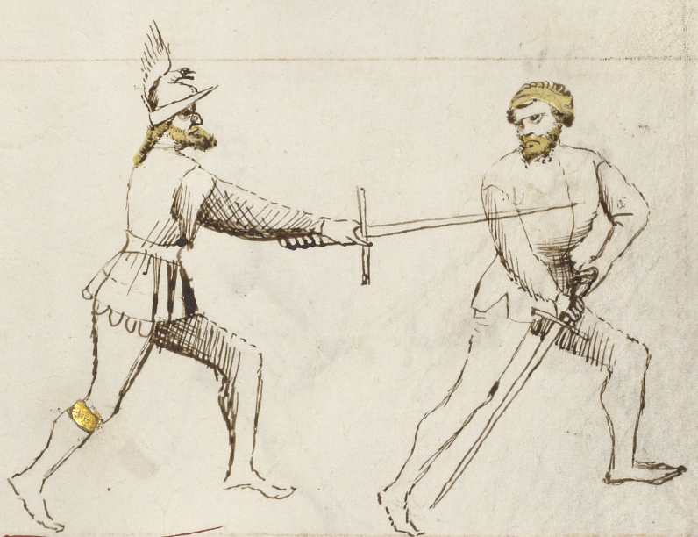
Plate 5: (25r-d) 5th Student (counter and counter-counter)
Sword in
Two Hands
Long Range
In the previous drawing you saw the Peasant’s Strike, in which you saw a thrust well-placed into the attacker’s chest. And alternatively he could have struck a downward blow to the opponent’s head or the arms, as I explained previously. Also, if the opponent seeks to counter me by striking back up with a rising blow to my arms from the left, I quickly advance my left foot and place my sword over his, and from this position he can do nothing to me.

